Slide 1
Coping with change
Change is inevitable in all large software projects.
  Business changes lead to new and changed system requirements
  New technologies open up new possibilities for improving implementations
  Changing platforms require application changes
Change leads to rework so the costs of change include both rework (e.g. re- analyzing requirements) as well as the costs of implementing new functionality

Slide 2
Reducing the costs of rework
Change avoidance, where the software process includes activities that can anticipate possible changes before significant rework is required.
  For example, a prototype system may be developed to show some key features of the system to customers.
Change tolerance, where the process is designed so that changes can be accommodated at relatively low cost.
  This normally involves some form of incremental development. Proposed changes may be implemented in increments that have not yet been developed. If this is impossible, then only a single increment (a small part of the system) may have be altered to incorporate the change.

Slide 3
Software prototyping
A prototype is an initial version of a system used to demonstrate concepts and try out design options.
A prototype can be used in:
  The requirements engineering process to help with requirements elicitation and validation;
  In design processes to explore options and develop a UI design;
  In the testing process to run back-to-back tests.

Slide 4
Benefits of prototyping
Improved system usability.
A closer match to users’ real needs.
Improved design quality.
Improved maintainability.
Reduced development effort.

Slide 5

The process of prototype development

Slide 6
Prototype development
May be based on rapid prototyping languages or tools
May involve leaving out functionality
  Prototype should focus on areas of the product that are not well-understood;
  Error checking and recovery may not be included in the prototype;
  Focus on functional rather than non-functional requirements such as reliability and security

Slide 7
Throw-away prototypes
Prototypes should be discarded after development as they are not a good basis for a production system:
  It may be impossible to tune the system to meet non-functional requirements;
  Prototypes are normally undocumented;
  The prototype structure is usually degraded through rapid change;
  The prototype probably will not meet normal organisational quality standards.

Slide 8
Incremental delivery
Rather than deliver the system as a single delivery, the development and delivery is broken down into increments with each increment delivering part of the required functionality.
User requirements are prioritised and the highest priority requirements are included in early increments.
Once the development of an increment is started, the requirements are frozen though requirements for later increments can continue to evolve.

Slide 9
Incremental development and delivery
Incremental development
  Develop the system in increments and evaluate each increment before proceeding to the development of the next increment;
  Normal approach used in agile methods;
  Evaluation done by user/customer proxy.
Incremental delivery
  Deploy an increment for use by end-users;
  More realistic evaluation about practical use of software;
  Difficult to implement for replacement systems as increments have less functionality than the system being replaced.

Slide 10
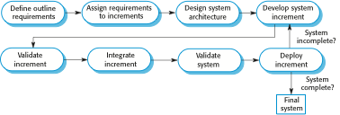
Incremental delivery

Slide 11
Incremental delivery advantages
Customer value can be delivered with each increment so system functionality is available earlier.
Early increments act as a prototype to help elicit requirements for later increments.
Lower risk of overall project failure.
The highest priority system services tend to receive the most testing.

Slide 12
Incremental delivery problems
Most systems require a set of basic facilities that are used by different parts of the system.
  As requirements are not defined in detail until an increment is to be implemented, it can be hard to identify common facilities that are needed by all increments.
The essence of iterative processes is that the specification is developed in conjunction with the software.
  However, this conflicts with the procurement model of many organizations, where the complete system specification is part of the system development contract.

Slide 13
Boehm’s spiral model
Process is represented as a spiral rather than as a sequence of activities with backtracking.
Each loop in the spiral represents a phase in the process.
No fixed phases such as specification or design - loops in the spiral are chosen depending on what is required.
Risks are explicitly assessed and resolved throughout the process.

Slide 14
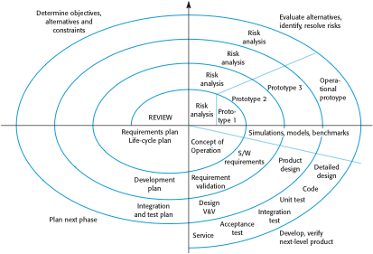
Boehm’s spiral model of the software process

Slide 15
Spiral model sectors
Objective setting
  Specific objectives for the phase are identified.
Risk assessment and reduction
  Risks are assessed and activities put in place to reduce the key risks.
Development and validation
  A development model for the system is chosen which can be any of the generic models.
Planning
  The project is reviewed and the next phase of the spiral is planned.

Slide 16
Spiral model usage
Spiral model has been very influential in helping people think about iteration in software processes and introducing the risk-driven approach to development.
In practice, however, the model is rarely used as published for practical software development.

